Slide 1

Application layer
Twinkle University | Computer Network Class

Slide 2

Title includes
Basics
OSI layer model
Explanations and Connections
Application layer
Conclusion

Slide 3

Basics
Oringinally Computer networking refers to interconnected computing devices that can exchange data and share resources with each other.
Since these networked devices use a system of rules, called communications protocols .
It is to transmit information over physical or wireless technologies to share resources located on or provided by network nodes.

Slide 4
Introduction to osi
Computer Networkings
The Open Systems Interconnection (OSI) model describes 7 layers that computer systems use to communicate over a network. It was the first standard model for network communications in early 90s.
The modern Internet is not based on OSI, but on the simpler TCP/IP model. However, the OSI 7-layer model is still widely used, as it helps visualize and communicate how networks works.
OSI was introduced in 1983 by representatives of the major computer and telecom companies, and was adopted by ISO as an international standard in 1984.

Slide 5

Osi explantions
7 layers of OSI Model
We’ll describe OSI layers “top down” from the application layer that directly serves the end user, down to the physical layer.
Application Layer
Presentation Layer
Section Layer
Transport Layer
Network Layer
Data Link Layer
Physicak Layer

Slide 6
Connection between OSI & Application layer
OSI Layer Model
Applcation Layer
The application layer is used by end-user software such as web browsers and email clients. It provides protocols that allow software to send and receive information and present meaningful data to users.
A few examples of application layer protocols are the Hypertext Transfer Protocol (HTTP), File Transfer Protocol (FTP), Post Office Protocol (POP), Simple Mail Transfer Protocol (SMTP), and Domain Name System (DNS).
The Application Layer is topmost layer in the Open System Interconnection (OSI) model. This layer provides manipulating the data which actually enables any type of user to access network with ease.
The Application Layer interface directly interacts with application and provides common web app services. This layer is basically highest level of open system provides services directly for application process.

Slide 7
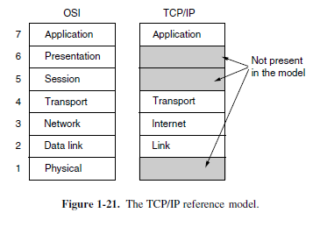
What is application Layer ?
The application layer is actually an abstraction layer that specifies the shared protocols and interface methods used by hosts in a communication network.
Application Layer helps us to identify communication partners, and synchronizing communication.
This layer allows users to interact with other software applications
Illustraion of Application Layer In
OSI Model & TCP/IP Model

Slide 8
Application layer
OSI Layer Model
Data infos
Application
Layer
Protocols
SMTP
(Simple Mail Transfer Protocol)
Telenet (Telenet Network Protocol)
FTP (File Transfer Protocol)
MIME (Multipurpose Internet Mail Extension )
POP (Post Office Protocol )
HTTP (Hypertext Transfer Protocol )
DNS (Domain Name System )

Slide 9

Conclusion of application layer Application layer is a abstraction layer that specifies the shared communications protocols and interfacae method used by hosts in a communication network. An application layer abstraction is specified in both the internet protocol suite and osi model

Slide 10



THANK YOU
WWW.FABRIKAM.COM
Twinkle University
+1 (589) 555‐0199
Twinkle@fabrikam.com

